Slide 1
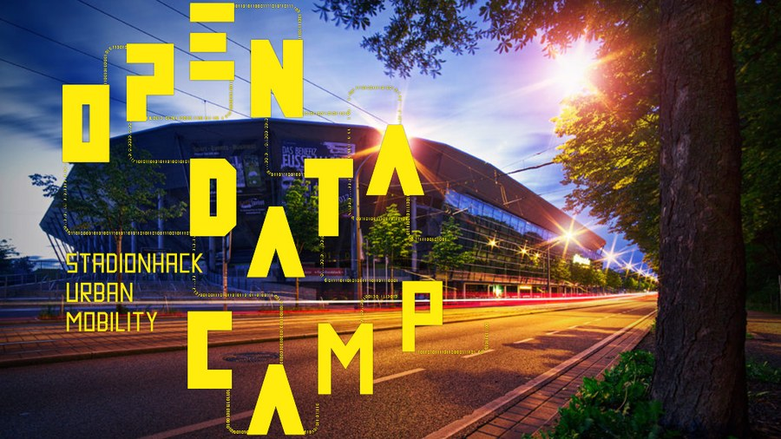
Team Traffic Nerds

Slide 2
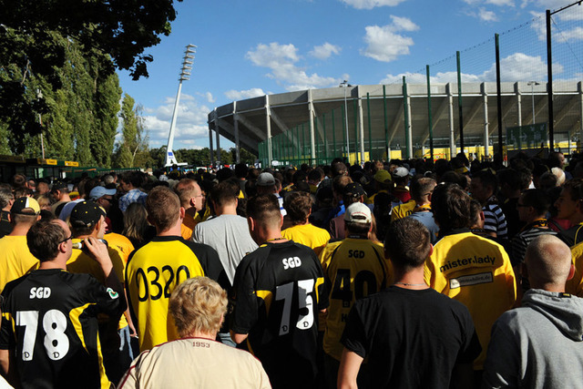
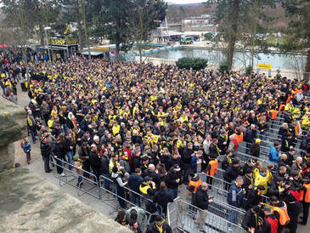

Slide 4
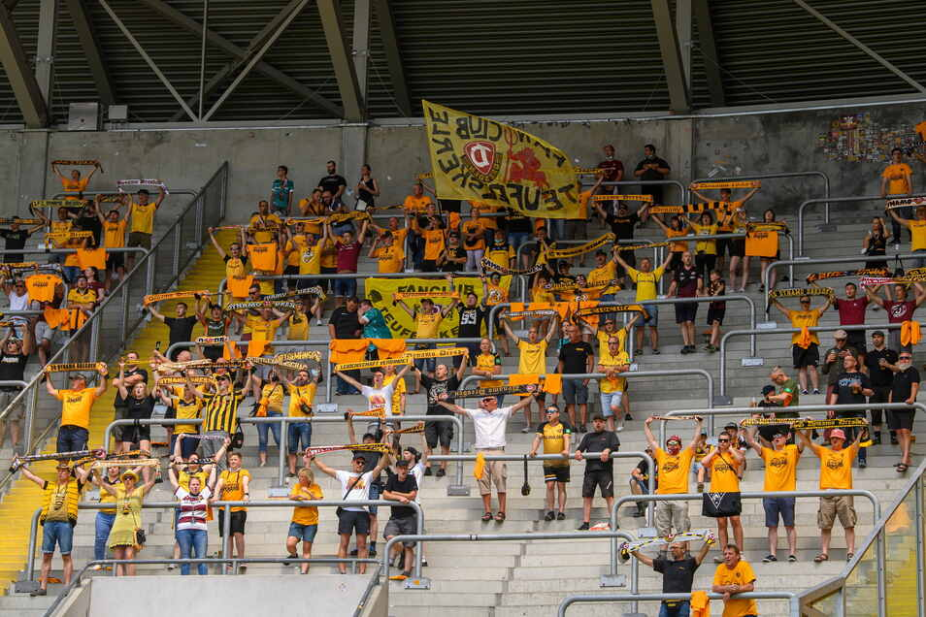

Slide 5
Historical Model
Rule-based Model
Arrival Time Notification

Slide 6
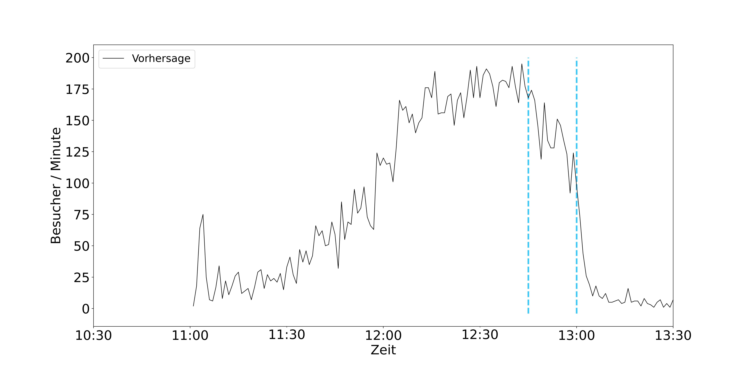
Historical Model
Rule-based Model
Arrival Time Notification

Slide 7
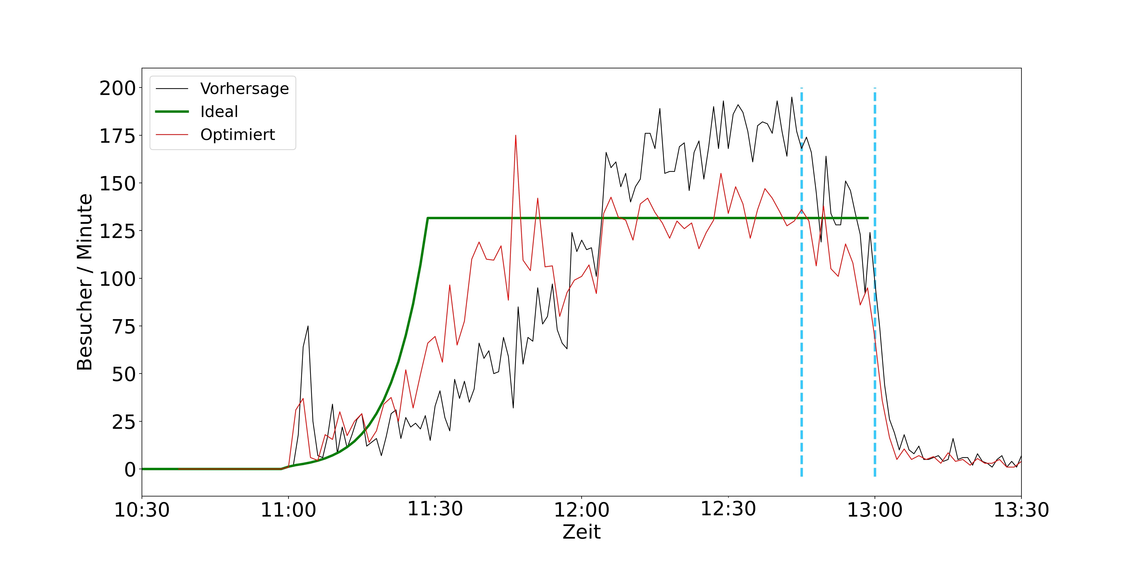
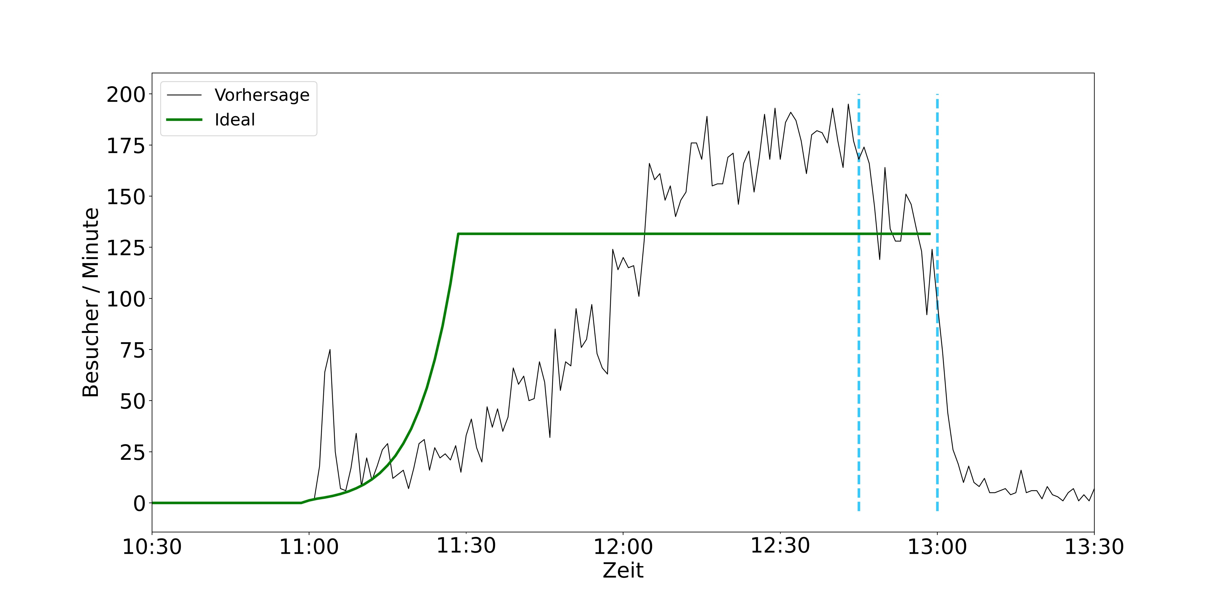
Historical Model
Rule-based Model
Arrival Time Notification

Slide 8
Historical Model
Rule-based Model
Arrival Time Notification

Slide 9
Historical Model
Rule-based Model
Arrival Time Notification

Slide 10
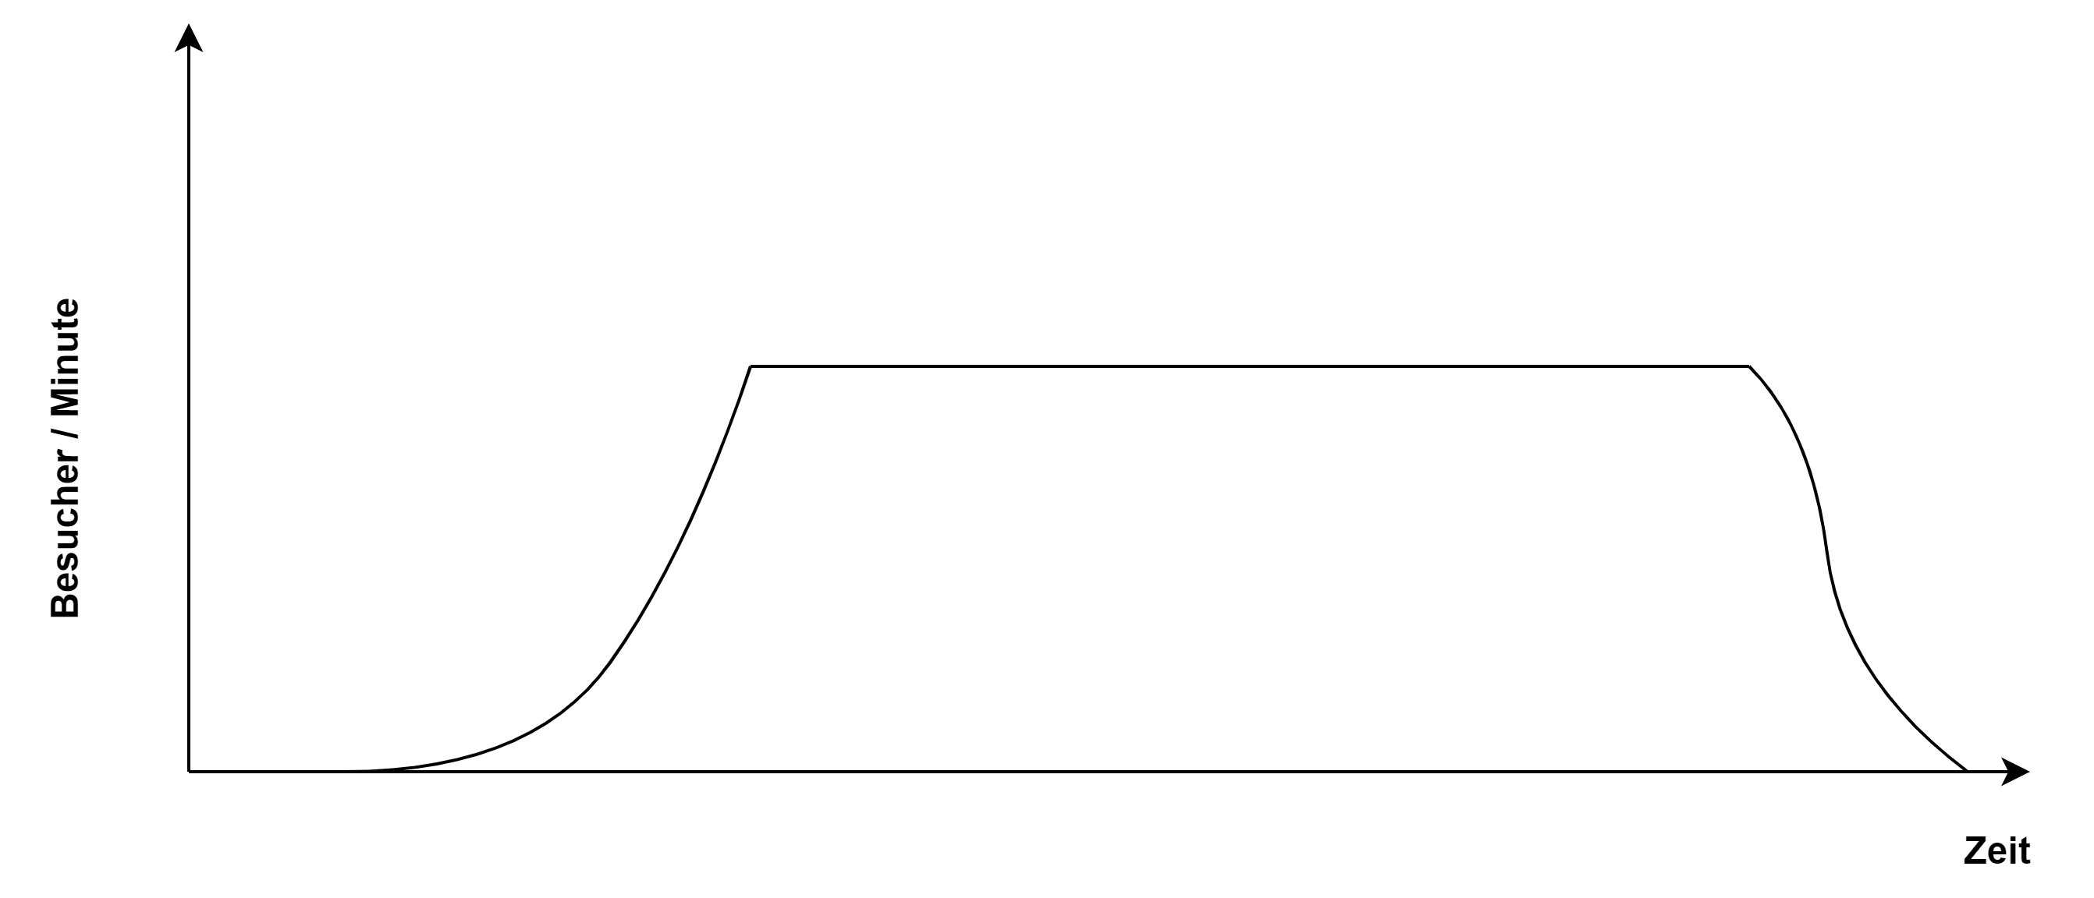

Slide 11
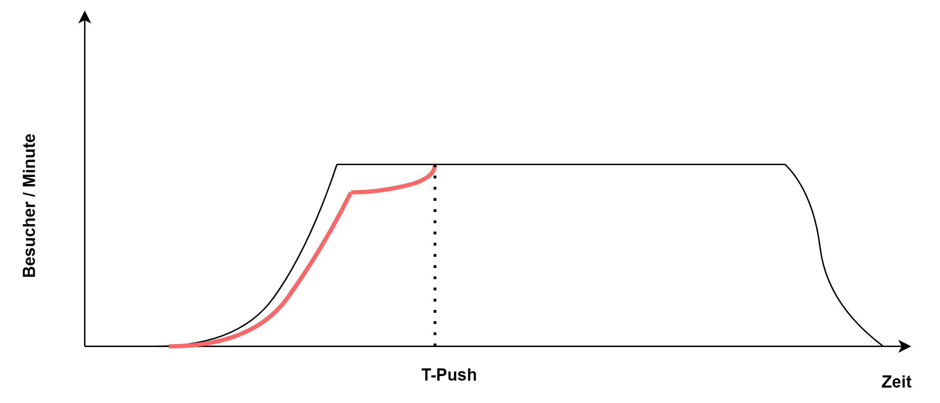

Slide 12
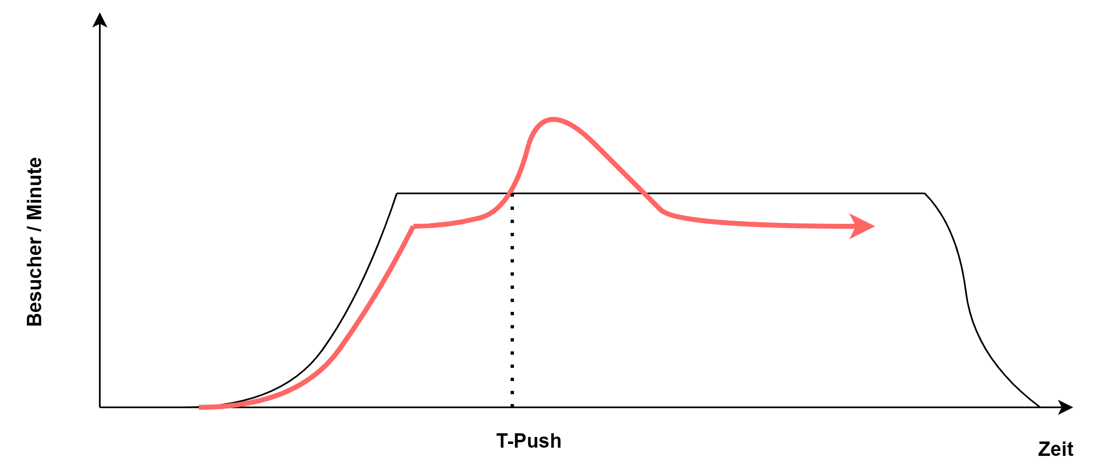

Slide 13
Vorteile unserer Lösung
Stress ↓
Umsätze Stadion ↑
Gezielter Einlass für Ältere & Familien
Sponsorenkontakt im Stadion ↑
Planbarkeit Ordnungskräfte ↑
Erweiterbarkeit

Slide 14
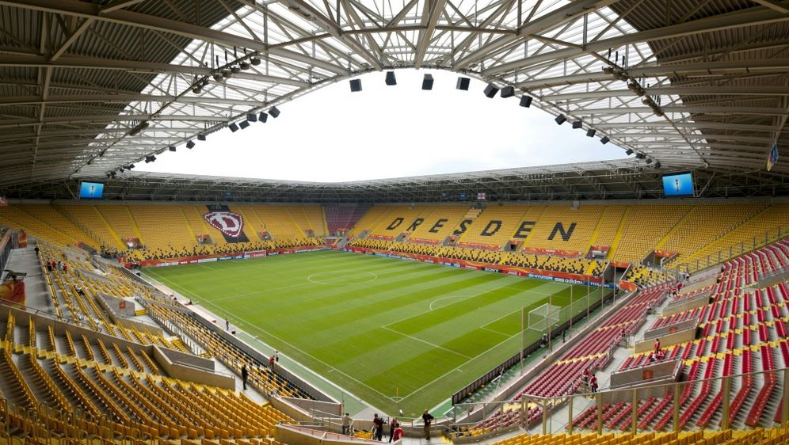
Challenge 5: Besucherstromprognose
Traffic Nerds Lösung: Dynamo Arrival
Jan Klein
Noah Mertens
Jonas Zimmermann
Ankith Bheemanakone Venkatagiri
John – Robert Scholz

Slide 16
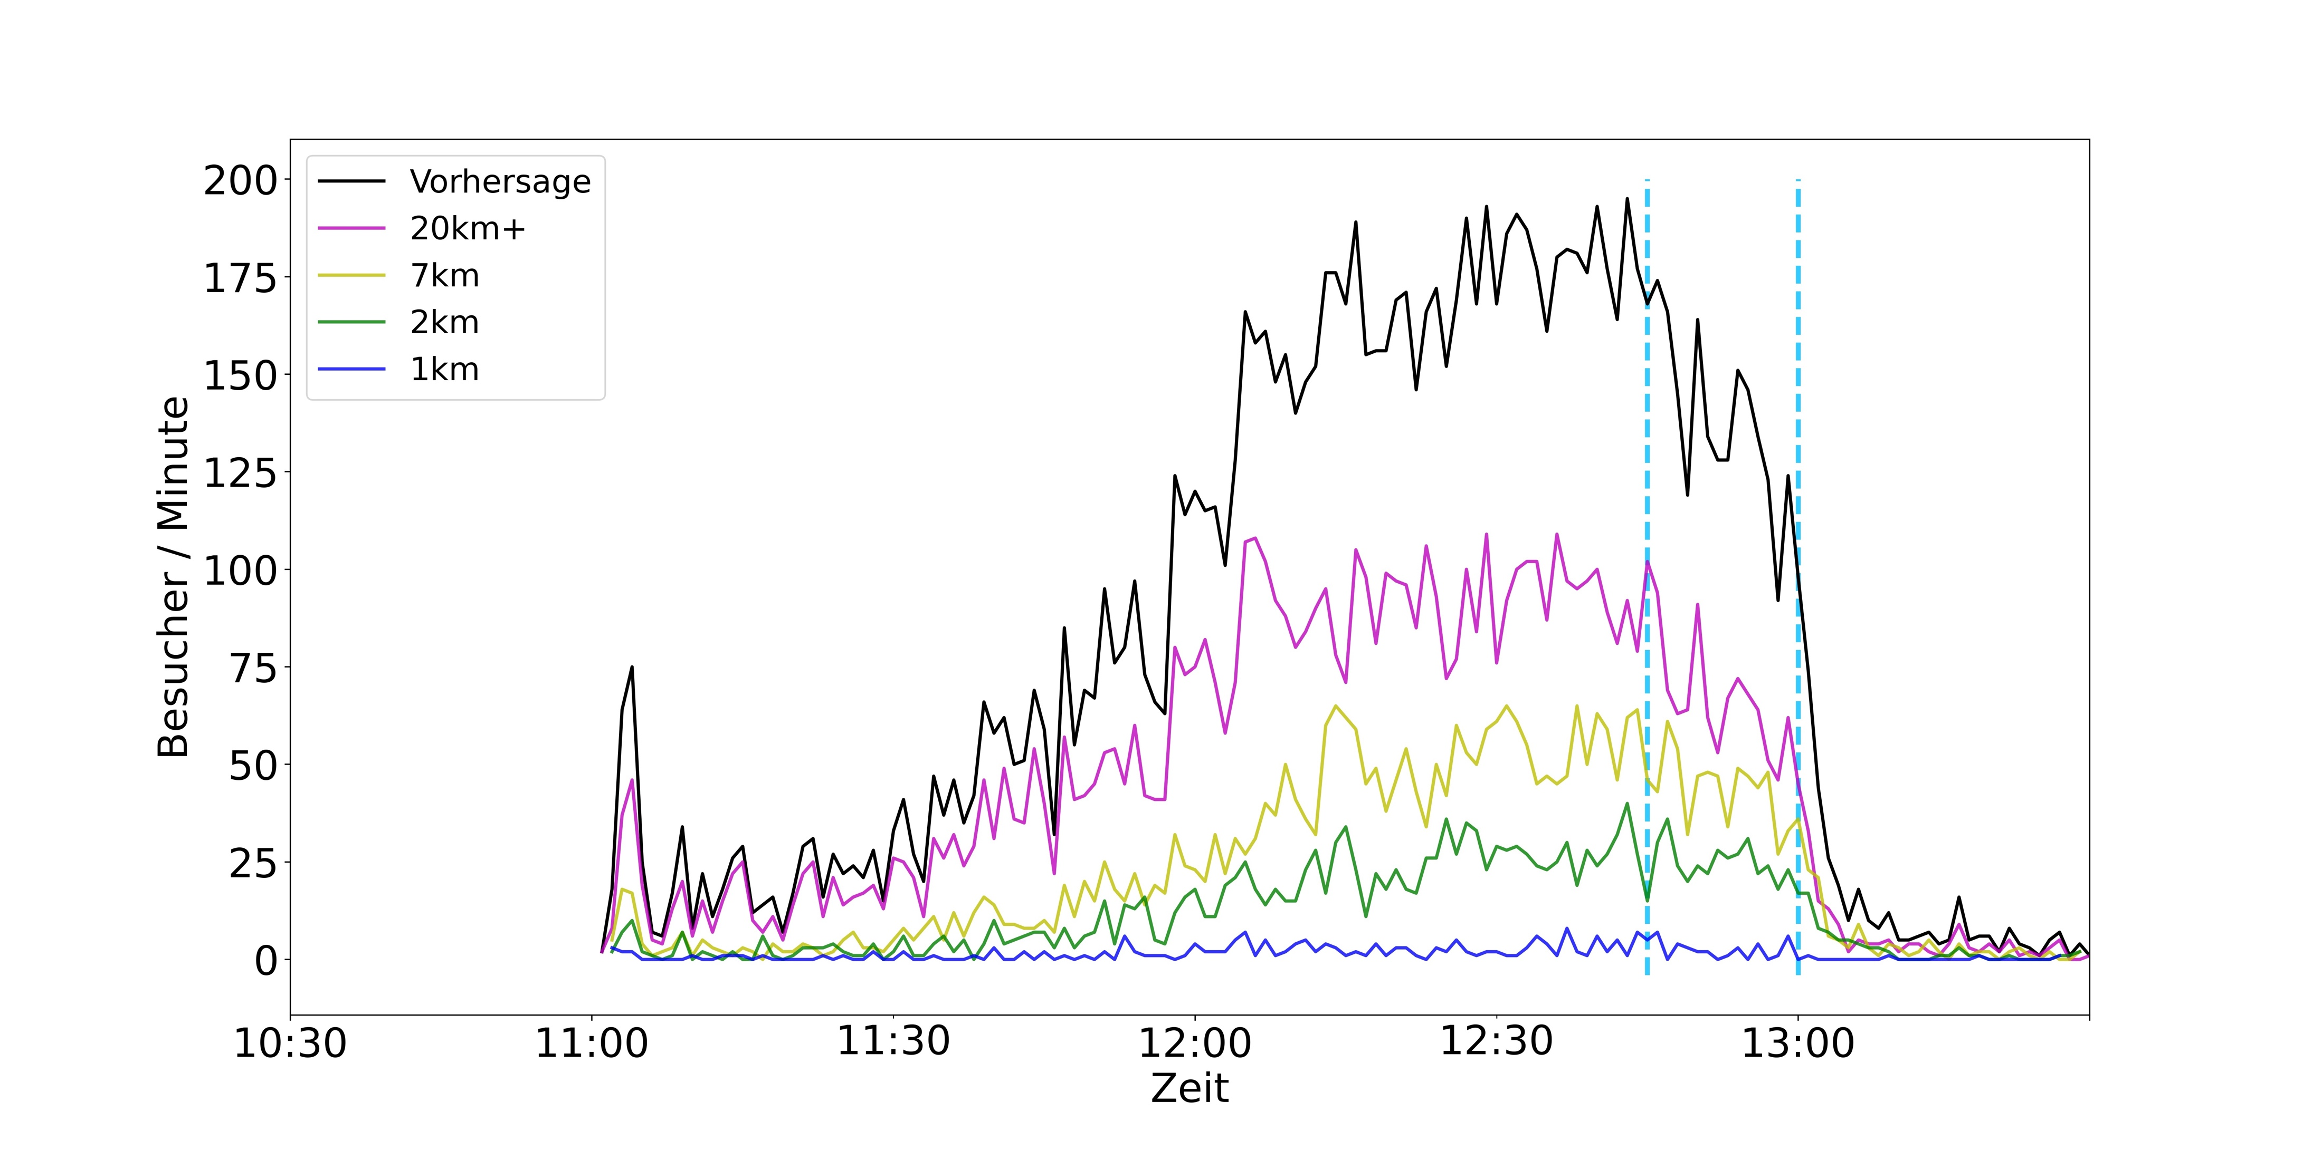
Aufschlüsselung Vorhersage nach PLZ

Slide 17
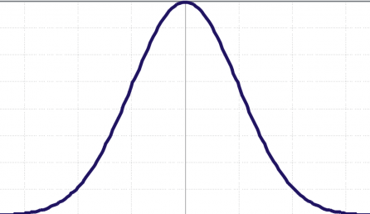
Hist. Model
Rule based Model
Notification nah/mid /fern
Hist. Data
Rule 1
ETIX + ZIP
Rule 2
Camera Input
Survey
Real Time Scanning
Weather
Correction Model
Push

Slide 18
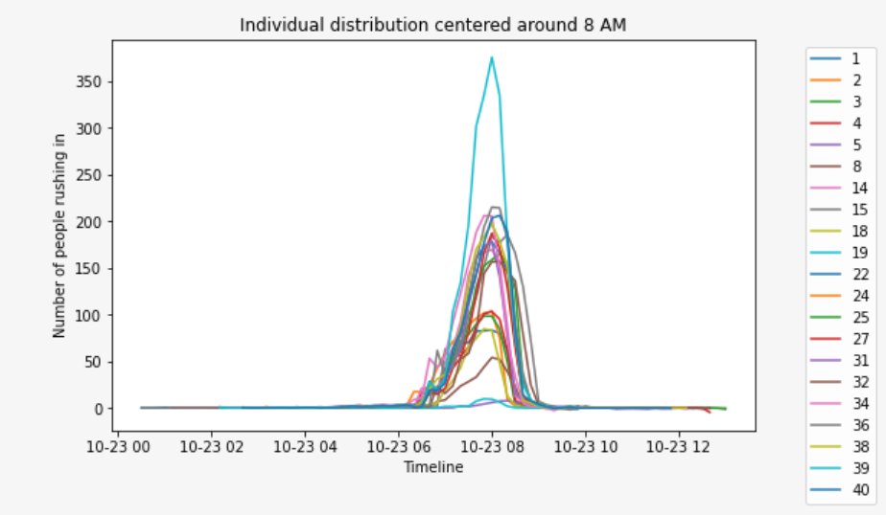

Slide 19
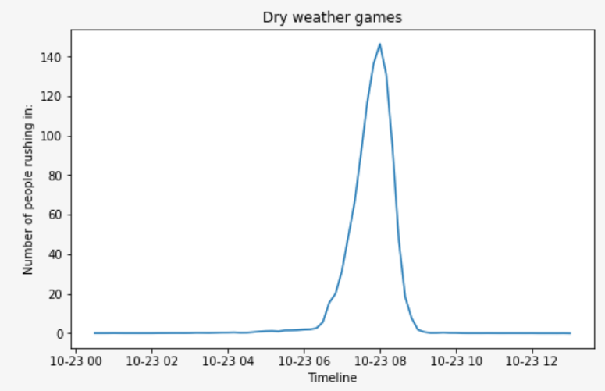

Slide 20
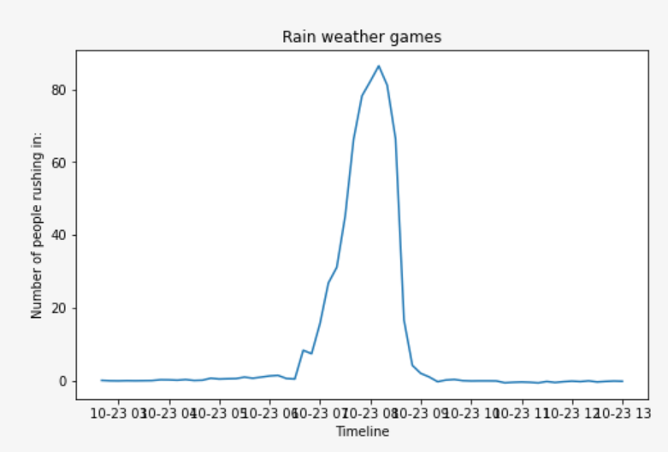

Slide 21
